Slide 1
Rational Agents

Slide 2
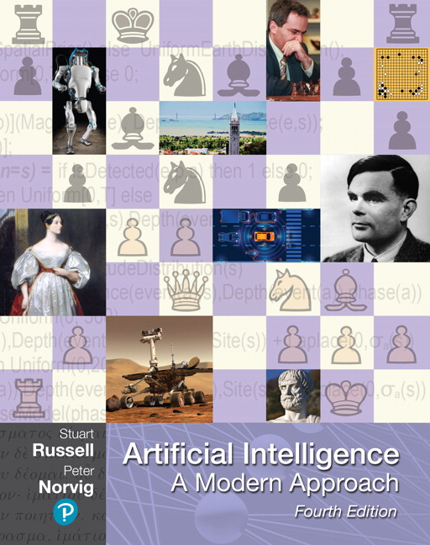
Outline for today’s lecture
Intelligent Agents (AIMA 2.1-2.4)
Task Environments
Formulating Search Problems
Uninformed Search (AIMA 3.1-3.4)

Slide 3
Four views of Artificial Intelligence
This course is about effective programming techniques for designing rational agents
Thinking humanly | Thinking rationally
Acting humanly | Acting rationally

Slide 4
Agents
An agent is anything that perceives its environment through sensors and can act on its environment through actuators
A percept is the agent’s perceptual inputs at any given instance.

Slide 5
What about your robot?
What actuators does it have?
What sensors does it have?

Slide 6
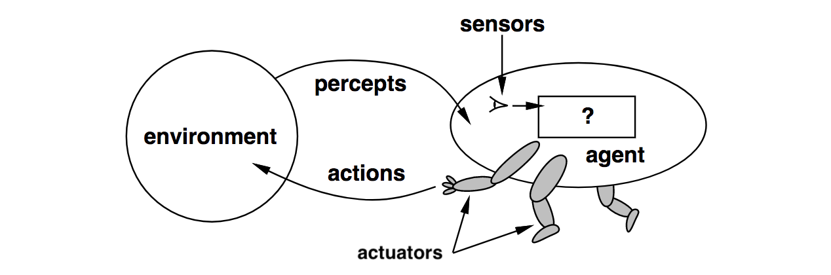
Agents and environments
An agent is specified by an agent function f:P→ a that maps a sequence of percept vectors P to an action a from a set A:
P=[p₀, p₁, … , p_{t}]
A={a₀, a₁, … , a_{k}}
abstract mathematical description
Notes:
Mathematically speaking, we say that an agent’s behavior is described by the agent function that maps any given percept sequence to an action.

Slide 7
Agent function & program
The agent program runs on the physical architecture to produce f
agent = architecture + program
“Easy” solution: a giant table that maps every possible sequence P to an action a
One small problem: exponential in length of P
Notes:
Internally, the agent function for an artificial agent will be implemented by an agent program.
The agent function is an abstract mathematical description;
The agent program is a concrete implementation, running within some physical system.

Slide 8
Agents
An agent is anything that can be viewed as
perceiving its environment through sensors and
acting upon that environment through actuators
Human agent:
Sensors: eyes, ears, ...
Actuators: hands, legs, mouth, …
Robotic agent:
Sensors: cameras and infrared range finders
Actuators: various motors
Agents include humans, robots, softbots, thermostats, …
Notes:
Thermostats?!?!?! Yes, they are self–regulating and foundational to the field of Control Theory, which was one of the fields that gave raise to AI.

Slide 9
Acting rationally
Rational behavior: doing the right thing
The right thing: that which is expected to maximize goal achievement, given the available information
Rational agent: An agent is an entity that perceives and acts rationally
This course is about effective programming techniques for designing rational agents

Slide 10
Rational Agent
Let’s try to define “rational agent”.
A rational agent is an agent that perceives its environment and and behaves rationally
Rational behavior: doing the right thing
Obviously doing the right thing is better than doing the wrong thing, but what does it mean to do the right thing?

Slide 11

In Philosophy
Moral philosophy has developed different notions of “the right thing”.
AI is usually concerned with Consequentialism.
We evaluate an agent’s behavior by its consequences.
Herbert Simon
The Good Place
Notes:
Moral philosophy has developed different notions of “the right thing”. AI is usually concerned with Consequentialism. We evaluate an agent’s behavior by its consequences.
When an agent is put into an environment, it generates a sequence of actions based on the percepts that it receives. This sequence of actions causes the environment to go through a sequence of states. If these are desirable

Slide 12
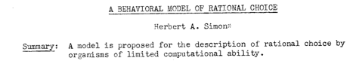
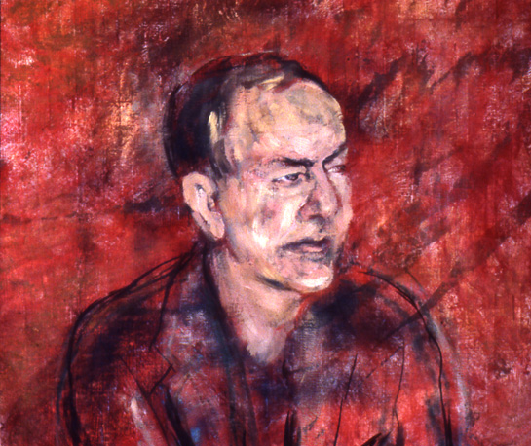
In Economics
Rational choice theory is a framework for understanding social and economic behavior.
The basic premise s that aggregate social behavior results from the behavior of individual actors, each of whom is making their individual decisions.
It assumes that individuals have preferences and choose the alternative that they prefer.
Herbert Simon
Notes:
Rational choice theory, also known as choice theory or rational action theory, is a framework for understanding and often formally modeling social and economic behavior.^{[1]} The basic premise of rational choice theory is that aggregate social behavior results from the behavior of individual actors, each of whom is making their individual decisions. The theory also focuses on the determinants of the individual choices (methodological individualism). Rational choice theory then assumes that an individual has preferences among the available choice alternatives that allow them to state which option they prefer.
Herb Simon was an economist, political scientist and cognitive psychologist, whose primary research interest was decision-making and is best known for his theory of "bounded rationality"
1953.
He received the Nobel Prize in Economics in 1978 and the Turing Award in 1975.

Slide 13
Performance measure
How do we know if an agent is acting rationally?
Informally, we expect that it will do the right thing in all circumstances.
How do we know if it’s doing the right thing?
We define a performance measure:
An objective criterion for success of an agent's behavior
given the evidence provided by the percept sequence.
Notes:
Consider an alternative performance measure for the vacuum-cleaner agent. We measure performance by the amount of dirt cleaned up in a single eight-hour shift. With a rational agent, of course, what you ask for is what you get. A rational agent can maximize this performance measure by cleaning up the dirt, then dumping it all on the floor, then cleaning it up again, and so on.

Slide 14
Performance measure - example
A performance measure for a vacuum-cleaner agent might include e.g. some subset of:
+1 point for each clean square in time T
+1 point for clean square, -1 for each move
-1000 for more than k dirty squares
Notes:
Consider an alternative performance measure for the vacuum-cleaner agent. We measure performance by the amount of dirt cleaned up in a single eight-hour shift. With a rational agent, of course, what you ask for is what you get. A rational agent can maximize this performance measure by cleaning up the dirt, then dumping it all on the floor, then cleaning it up again, and so on.

Slide 15
Performance measure – rule of thumb
It is better to design performance measures according to what you want to be achieved in the environment, rather than how you think the agent should behave.
For example what might happen if we said
+1 point for each time the robot cleans a square
instead of
+1 point for each clean square in time T

Slide 16
Rational agents
Rational Agent:
For each possible percept sequence P
a rational agent selects an action a
to maximize its performance measure

Slide 17
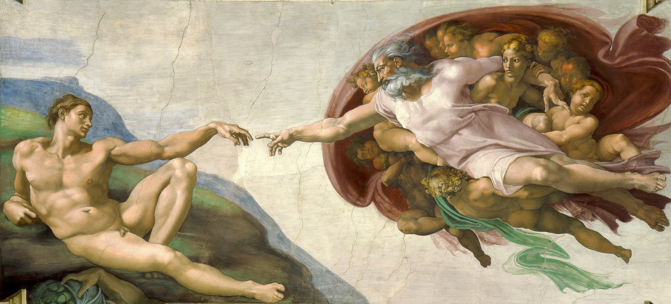
Is omniscience required?
Notes:
Ideal agent: maximizes actual performance, but needs to be omniscient.
Usually impossible…..
But consider tic-tac-toe agent…
Rationality  Guaranteed Success
Caveat: computational limitations make complete rationality unachievable
design best program for given machine resources

Slide 18
Rationality is not omniscience
Ideal agent: maximizes actual performance, but needs to be omniscient.
Usually impossible…..
But consider tic-tac-toe agent…
Rationality ≠ Guaranteed Success
Caveat: computational limitations make complete rationality unachievable
design best program for given machine resources

Slide 19
Expected value
Rational Agent (initial definition):
For each possible percept sequence P,
a rational agent selects an action a
to maximize its performance measure
Rational Agent (revised definition):
For each possible percept sequence P,
a rational agent selects an action a
that maximizes the expected value of its performance measure
It doesn’t have to know what the actual outcome will be.

Slide 20

Task environments
To design a rational agent we need to specify a task environment
a problem specification for which the agent is a solution
PEAS: to specify a task environment
Performance measure
Environment
Actuators
Sensors

Slide 21
PEAS: Specifying an automated taxi driver
Performance measure:
?
Environment:
?
Actuators:
?
Sensors:
?
Notes:
Performance measure:
safe, fast, legal, comfortable, maximize profits
Environment:
roads, other traffic, pedestrians, customers
Actuators:
steering, accelerator, brake, signal, horn
Sensors:
cameras, sonar, speedometer, GPS

Slide 22
PEAS: Specifying an automated taxi driver
Performance measure:
safe, fast, legal, comfortable, maximize profits
Environment:
roads, other traffic, pedestrians, customers
Actuators:
steering, accelerator, brake, signal, horn
Sensors:
cameras, LiDAR, speedometer, GPS
Notes:
Lidar acronym for light detection and ranging

Slide 23
PEAS: Amazon Prime Air
Performance measure:
?
Environment:
?
Actuators:
?
Sensors:
?
Notes:
https://www.today.com/video/amazon-debuts-new-package-delivery-drone-61414981780
https://nbcnewsencoding-vh.akamaihd.net/i/nbcnews/video/2019/06/tdy_news_costello_amazon_190606_893856774.mp4,,.csmil/master.m3u8?__b__=1000

Slide 24
https://www.today.com/video/amazon-adebuts-new-package-delivery-drone-61414981780

Slide 25
PEAS: Specifying an Amazon delivery drone
Performance measure:
maximize profits - minimize time - obey laws governing airspace restrictions - deliver package to right location - keep package in good condition - avoid accidents - reduce noise - preserve battery life
Environment:
- airspace - obstacles when airborne (other drones, birds, buildings, trees, utility poles) - obstacles when landing (pets, patio furniture, lawnmowers, people, cars) - weather - distances/route information between warehouse and destinations - position of houses, and spaces that are safe for drop-off- package weight
Notes:
Performance measure:
safe, fast, legal, comfortable, maximize profits
Environment:
roads, other traffic, pedestrians, customers
Actuators:
steering, accelerator, brake, signal, horn
Sensors:
cameras, sonar, speedometer, GPS

Slide 26
PEAS: Specifying an Amazon delivery drone
Actuators:
- Propellers and flight control system- Payload actuators: E.g. Arm/basket/claw for picking up, dropping off packages- Lights or signals - Mechanism to announce/verify delivery- Device for delivering packages to customers
Sensors:
GPS - radar/Lidar- altitude sensor- weather sensors (barometer, etc). - gyroscope- accelerometer- camera- rotor sensors- weight sensor to recognize package
Notes:
Performance measure:
safe, fast, legal, comfortable, maximize profits
Environment:
roads, other traffic, pedestrians, customers
Actuators:
steering, accelerator, brake, signal, horn
Sensors:
cameras, sonar, speedometer, GPS

Slide 27
The rational agent designer’s goal
abstract mathematical description
Goal of AI practitioner who designs rational agents:
given a PEAS task environment,
Construct agent function f that maximizes the expected value of the performance measure,
Design an agent program that implements f on a particular architecture
concrete implementation
Notes:
The agent function is an abstract mathematical description;
The agent program is a concrete implementation, running within some physical system.

Slide 28
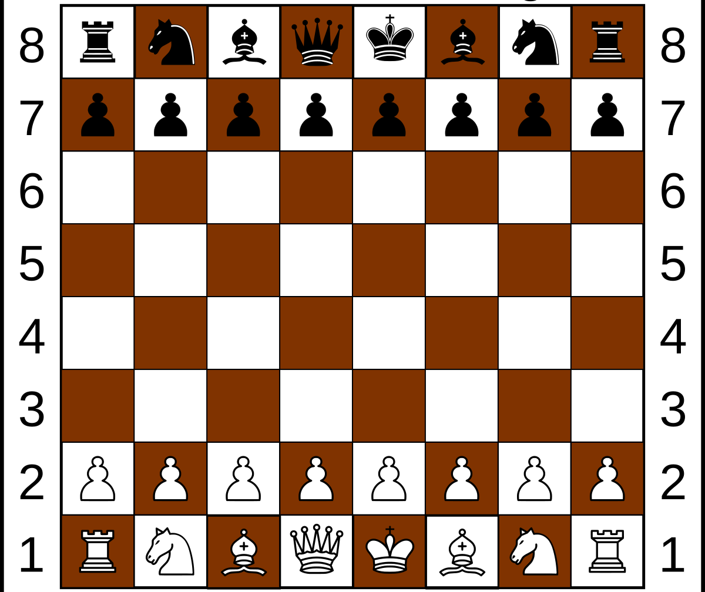
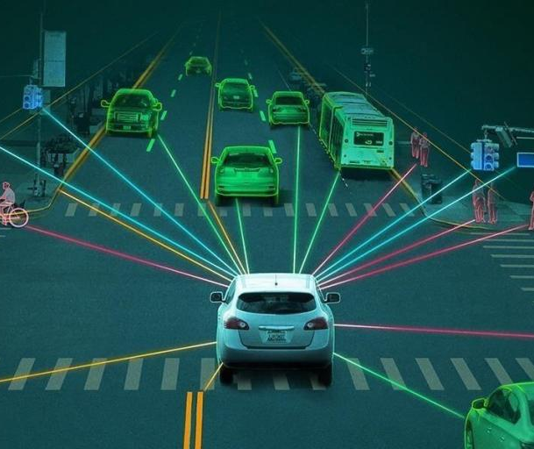
Fully Observable v. Partially Observable

Slide 29
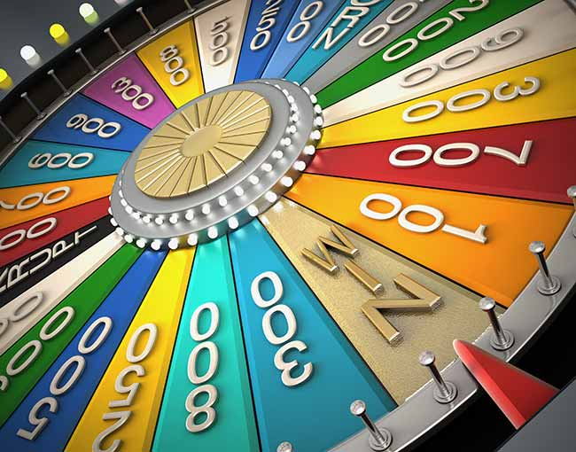
Deterministic v. Nondeterministic v. Stocastic
Notes:
Deterministic (vs. stochastic): The next state of the environment is completely determined by the current state and the action executed by the agent.
If the environment is deterministic except for the actions of other agents, then the environment is strategic.

Slide 30
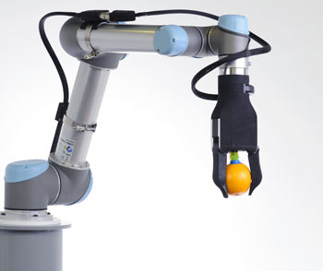
Episodic v. Sequential
Notes:
The agent's experience is divided into atomic "episodes" during which the agent perceives and then performs a single action, and the choice of action in each episode does not depend on any previous action.
In sequential environments, the current decision could affect all future decisions

Slide 31
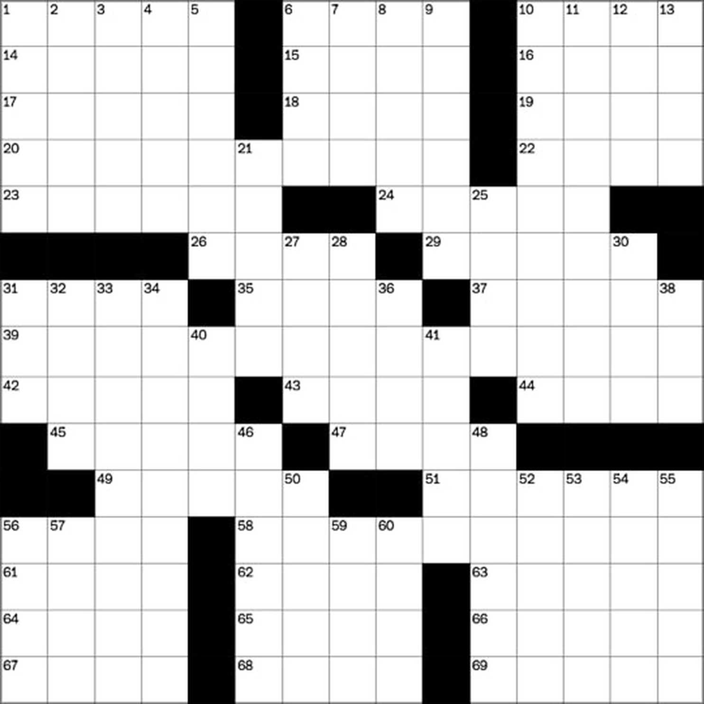
Static v. Dynamic
Notes:
Static (vs. dynamic): The environment is unchanged while an agent is deliberating.
The environment is semidynamic if the environment itself does not change with the passage of time but the agent's performance score does. Chess with a clock is semidynamic.

Slide 32
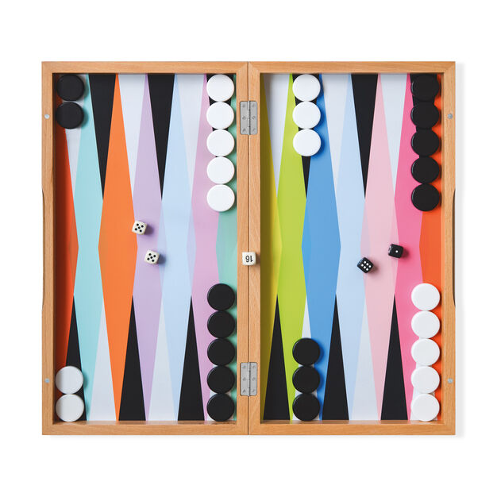
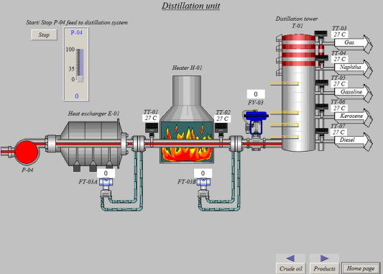
Discrete v. Continuous
Notes:
Discrete (vs. continuous): A limited number of distinct, clearly defined percepts and actions.

Slide 33
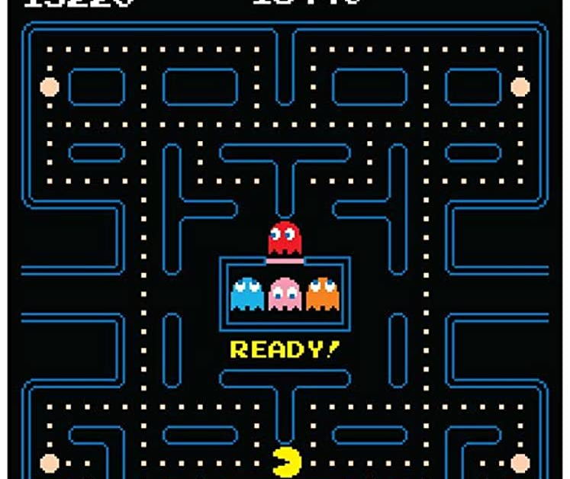
Single Agent v. Multi Agent
Notes:
Multi-agent: Does agent A (the taxi driver) need to treat object B (another vehicle) as an agent, or can it merely be treated as an object behaving according to the laws of physics? Is B’s behavior best described as maximizing a performance measure? Does that also depend on agent A’s behavior? Is it competitive or cooperative?
CCB – write the next slide on the board

Slide 34
When should something be considered an agent?
When should something be considered another agent?
If we’re talking about a self driving taxi, when should we consider something part of the environment versus another agent?
For instance, a telephone pole is part of the environment, but a car might be another agent.
When something behavior can best be described as having its own performance measure, then we should consider it to be an agent.

Slide 35
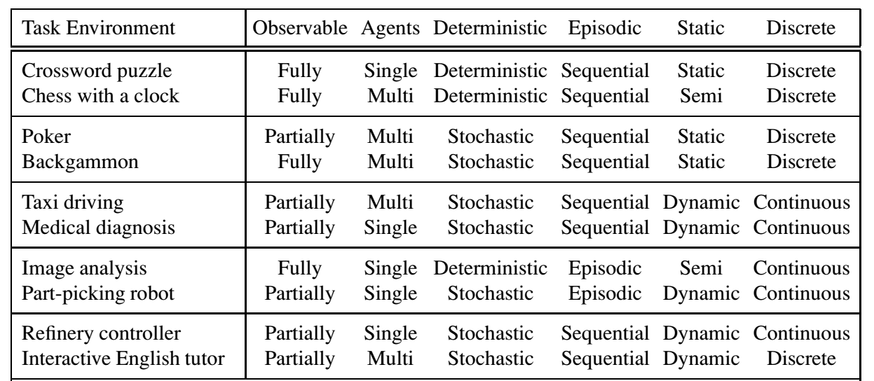
Examples

Slide 36
The Hardest Environment
The hardest case is
Continuous
Partially Observable
Stochastic
Continuous
Multiagent
Unknown Outcomes

Slide 37
Environment Restrictions for Now
We will assume environment is
Static
Fully Observable
Deterministic
Discrete

Slide 38
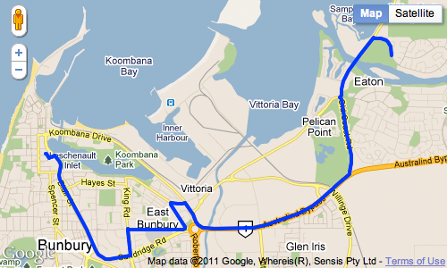
Reflex agents v. Problem solving agents
A simple reflex agent is one that selects an action based on the current percept, and ignores the rest of the percept history.
A problem-solving agent must plan ahead. It will consider a sequence of actions that form a path to a goal state. The computational process that it undertakes is called search.

Slide 39
Problem Solving Agents & Problem Formulation
AIMA 3.1-3.2

Slide 40
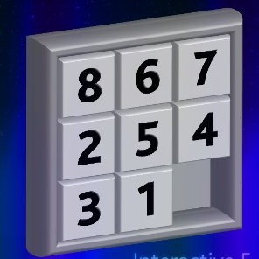

Example search problem: 8-puzzle
Formulate goal
Pieces to end up in order as shown…
Formulate search problem
States: configurations of the puzzle (9! configurations)
Actions: Move one of the movable pieces (≤4 possible)
Performance measure: minimize total moves
Find solution
Sequence of pieces moved: 3,1,6,3,1,…
Notes:
Sometimes a performance measure can be formulated in whether an agent satisfies a goal.
This Is called a sliding block puzzle. This instance is an 8-puzzle.
9!/2 = 181k
Family of sliding block puzzles are NP complete. 15 block puzzle (4x4 board has 1.3 trillion states (1.3*10^12).
5x5 board has 10^25 states.

